Slide 1
Advanced Techniques with Large Language Models Lecture 1
Northeastern University
College of Engineering
Multidisciplinary Graduate Engineering Department
INFO 7374 – Fall 2025
Instructor: Abdolreza Mosaddegh

Slide 2
Course Overview
Course: Advanced Techniques with Large Language Models (INFO 7374)
Instructor: Abdolreza Mosaddegh
Assistant Professor of AI, Northeastern University
AI Researcher, Cornell University
Office: Mills Hall 330
Email / Teams : a.mosaddegh@northeastern.edu
TA: Hangyeol Kim
Email / Teams : kim.hang@northeastern.edu
Canvas: Assignments, Presentations, Datasets, Code Samples

Slide 3
Topics Covered in This Course
Fundamental Concepts of LLMs:
Fundamental Concepts of AI
Introduction to Neural Networks
NLP using Deep Neural Networks
Attention Mechanism
Transformer Architecture
Scaling LLMs
Employing LLMs:
Training and Fine-tuning of LLMs
Reasoning in LLMs
Knowledge Management in LLMs
Prompting
Agentic Frameworks
Alignment in LLMs and Future Directions

Slide 4
Assignments and Evaluations
 | % | Format | Goal
Assignments | 30% | Mainly coding (sometimes prompting) assignments that can be developed using any common programing language | To realize the discussed concepts
Quizzes | 20% | Mainly focused on numeric examples of methods (sometimes prompting), similar to examples covered in the class | To evaluate understanding of concepts discussed during the previous session
Midterm Exam | 10% | Similar to quizzes | To evaluate understanding of fundamental LLM concepts
Final Exam | 20% | Similar to quizzes | To evaluate understanding of topics in utilizing LLMs
Final Project | 20% | A practical project on real-world application of LLMs | To employ learned concepts and skills in real practices
Lecture | + 5% | Search about a topic and deliver a brief lecture (e.g., 10-15 minutes presentation) | To encourage exploring and sharing ongoing studies on LLMs

Slide 5
Recommended Publications
Natural Language Processing with Transformers, Lewis Tunstall, Leandro von Werra, and Thomas Wolf (Revised Edition, 2022)
Speech and Language Processing (2025), Dan Jurafsky and James H. Martin, Stanford's standard NLP textbook.
Neural Network Methods for Natural Language Processing (2017), Yoav Goldberg
Papers referenced in the presentation files

Slide 6
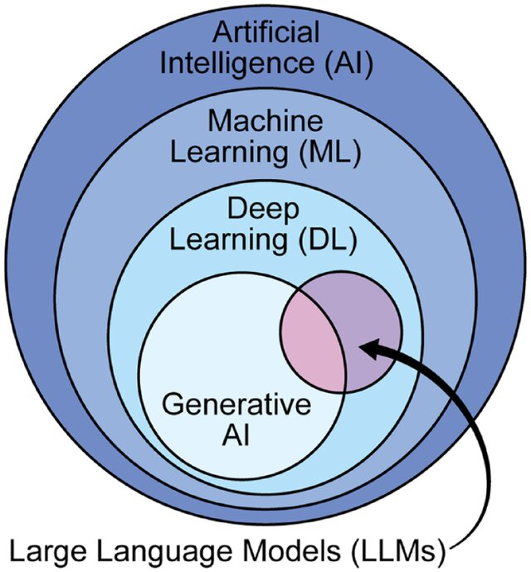
Definitions
Artificial Intelligence: a field of computer science enables machine to imitate human intelligence
Machine Learning: Field of study that gives computers the ability to learn from data without being explicitly programmed
Generative AI: a broad term that can be used for any AI system whose primary function is to generate content.
Large language model (LLM): Deep Learning models trained on huge amounts of data making them capable of processing natural language and other types of content to perform a wide range of tasks.

Slide 7
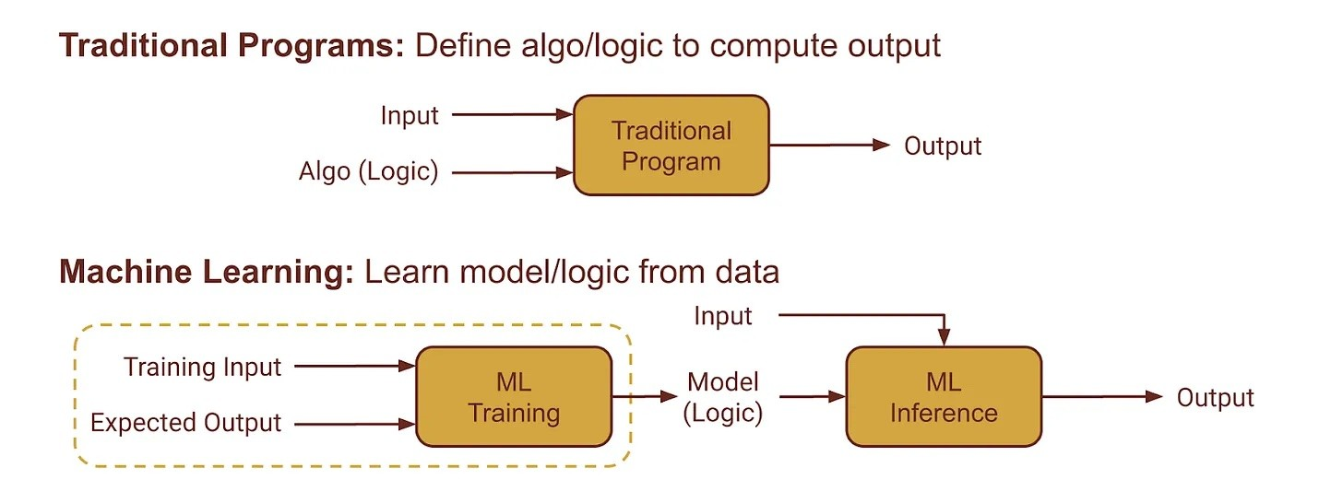
Machine Learning vs Programming
Programming: Explicit instructions for the computer to follow.
Machine Learning: Models can learn from data.

Slide 8
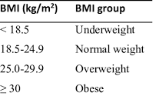
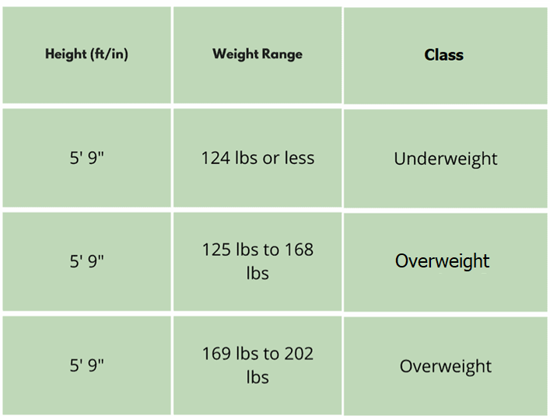
Machine Learning vs Programming - Example
Task: Grouping patients based on BMI
Programming based on logic provided by SME:
If (Weight / Height ^2) < 18.5 then Underweight
If (Weight / Height ^2) between 18.5 and 25 then Normal
…
Machine Learning based on logic learned from data:
Classify patients based on similarity in features (Height and Weight) with other patients in data records
Features
Labels

Slide 9
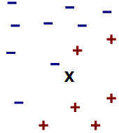
Example of Machine Learning- K Nearest Neighbors
K Nearest Neighbors (KNN) is a machine learning method (classifier)
KNN classifies a new data point based on similar data
Height
← Normal(-) or Underweight(+) Class?
Weight
Idea: Similar features indicates similar class (label)
Problem: We need a measure for similarity

Slide 10
Similarity : Less Distance in Features
Euclidean Distance:
Manhattan Distance:
Chebyshev Distance:
$$d(x,y)=\sqrt{(x−y)^{2}}=\sqrt{\sum_{i=1}^{d}{(x_{i}−y_{i})^{2}}}$$
$$d(x,y)=|x−y| =\sum_{i=1}^{d}{|x_{i}−y_{i}|}$$
$$d(x,y)=max_{1≤i≤d}|x_{i}−y_{i}|$$
1 2 3 4 5
Height
X (1,5)
$$Euclidean=\sqrt{\sum_{i=1}^{d}{(x_{i}−y_{i})^{2}}}= ({(1−3)}^{2}+{(5−1)}^{2})^{\frac{1}{2}}=4.47$$
$$Manhattan=\sum_{i=1}^{d}{|x_{i}−y_{i}|}=|\left(1−3\right)|+|(5−1)|=6$$
$$Chebyshev=Max(\left|\left(1−3\right)\right|,|(5−1)|)=4$$
$$4$$
Y (3,1)
$$2$$
Weight
1 2 3 4

Slide 11
KNN Example
Features: height(cm) and weight (kg)
Labels: Normal , Underweight
Weight | Height | Class (Label)
62 | 182 | Normal
69 | 176 | Normal
56 | 174 | Underweight
58 | 169 | Normal
57 | 173 | Underweight
55 | 170 | Normal
KNN Algorithm:
Classify new data based on similarity with existing data
Patient with Unknown Class
57 kg | 170 cm | ?

Slide 12




KNN Example – Calculate Distance
Euclidean Distance = $\sqrt{(Weight1−Weight2)^{2}+(Height1−Height2)^{2}}$
Weight | Height | Class | Euclidean Distance
62 | 182 | Normal | 13
69 | 176 | Normal | 13.4
56 | 174 | Underweight | 4.1
58 | 169 | Normal | 1.4
57 | 173 | Underweight | 3
55 | 170 | Normal | 2
$$\sqrt{(62−57)^{2}+(182−170)^{2}}$$
$$\sqrt{(69−57)^{2}+(176−170)^{2}}$$
$$…$$
57 kg | 170 cm | ?
Unknown data point

Slide 13
Classifying Based on Training Data
Class of x is assigned based on majority of k nearest neighbors
K is a parameter which controls the learning process (hyper-parameter)
Weight | Height | Class | Euclidean Distance
62 | 182 | Normal | 13
69 | 176 | Normal | 13.4
56 | 174 | Underweight | 4.1
58 | 169 | Normal | 1.4
57 | 173 | Underweight | 3
55 | 170 | Normal | 2
Programming approach (Explicit Instructions):
If (Weight / Height ^2) < 18.5 then
Underweight
If (Weight / Height ^2) between 18.5 and 25 then
Normal
K=3
Machine Learning Approach:
Classifies the patient based on learning from data
Normal
57 kg | 170 cm

Slide 14
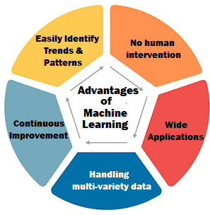
ML Advantages Over Programming
Adaptability : ML models can adapt to new data and improve over time without the need for extensive reprogramming. The codes need to be changed in traditional programing but can be the same in machine learning if the model is retrained on new data.
Complexity: Programing is effective for solving problems which can be addressed using explicit rules whereas machine learning is better suited for tackling more complex problems that require identifying patterns or relationships within data.
Programming (needs code development):
If (Weight / Height ^2) > 25 then Overweight
ML:
The same algorithm can learn new logic from new data
V. Sriram Lohit

Slide 15
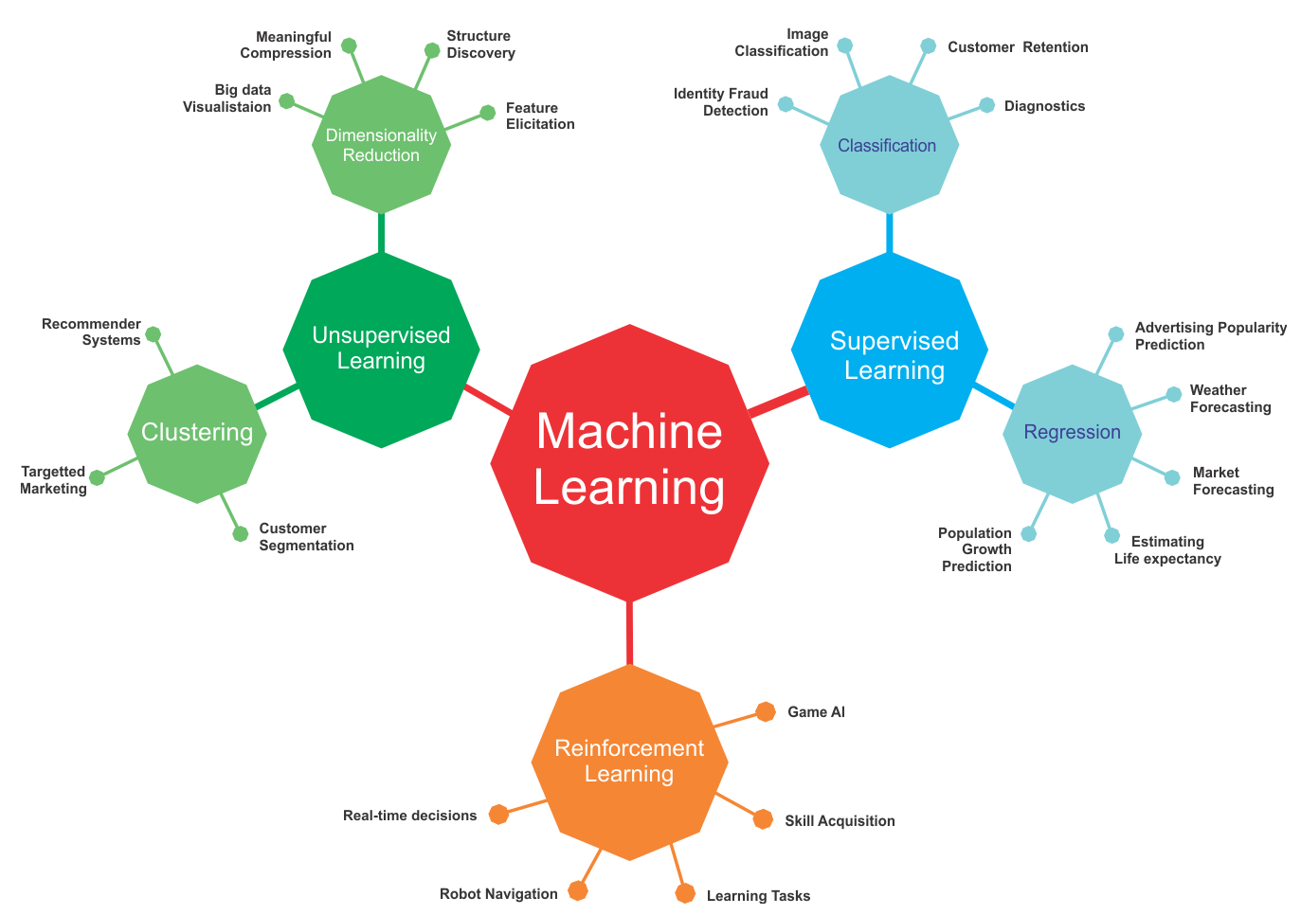
Semi-Supervised
Learning using unlabeled data
Self-Supervised
Learning using labeled data
packt
Learning through Interactions with an environment

Slide 16
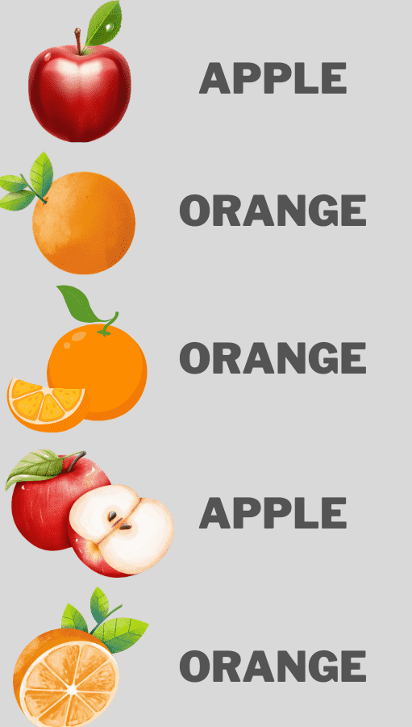


A Typical Supervised Learning
Labeled Training Data
“Apple”
“Orange”
“Features”
“Orange”
“Apple”
“Orange”
The feature extraction phase may be part of the machine learning algorithm itself
Training
Apple=0
Unknown Data /
Test Data
Classification Model
Predicted Label
Orange=1
“Features”
Production /
Testing

Slide 17
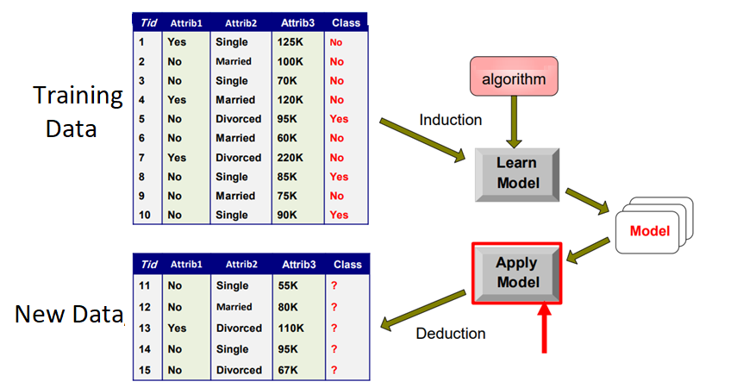
Phases in Typical Supervised Learning
Induction: Learning a model using an algorithm from training data (training)
Deduction: Applying the model to new data for predicting outcome (inference)
Training a model needs an algorithm
Induction of a model from training data is called fitting a model to the training data

Slide 18
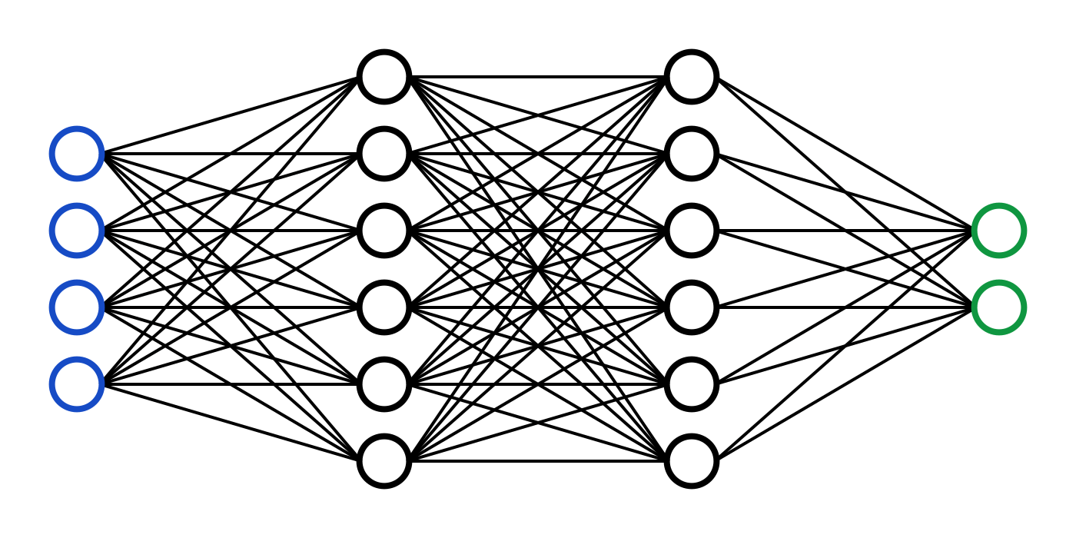
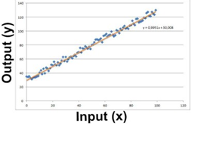
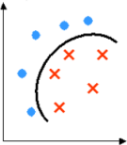
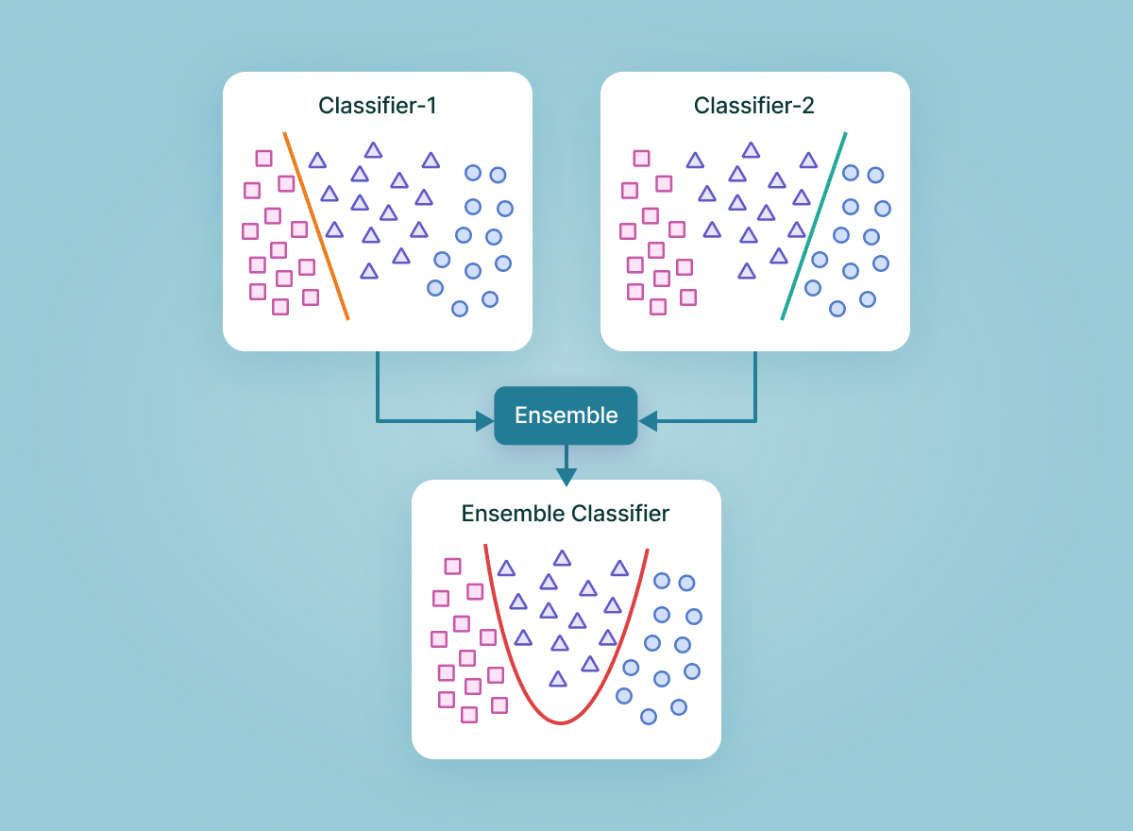
Some Supervised Algorithms
Regression
Learn a line/curve (the model) using training data consisting of
Input-output pairs.
Use it to predict the outputs for new inputs
Linear Regression
Logistic Regression
SVM
Neural Networks
Classification
Learn to separate different classes (the model) using training data consisting of input-output pairs
Use it to identify the labels for new inputs
Ensembles
Ensemble methods are machine learning techniques that combines several models in order to produce optimal models
Two-Class Nonlinear Classification
Decision Trees
Bayes Classifier
SVM
KNN
Neural Networks

Slide 19
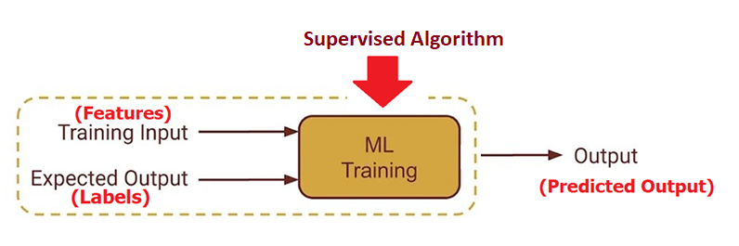
Supervised Learning - Training
Task: Learn to predict classes/values using features based on data in training set
Method: A supervised algorithm can be used for training of the model
Training data: Includes both inputs (features) and desired outputs (Labels)
Goal : Predict classes/ values with the highest accuracy (least error)
Features
Labels

Slide 20
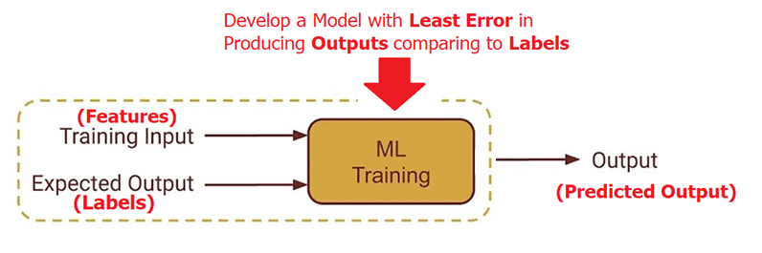
Problem Statement
Objective of Training: Predict classes/ values with the least error
Error: Differences between the real labels and predicted outputs of the model
Problem: To quantify the error, we need to define a measure
Solution: Define a loss function to compare the label against the output
Loss

Slide 21
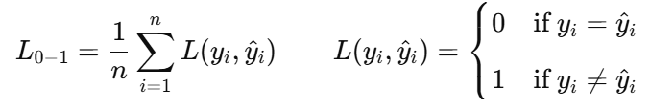
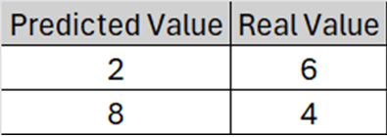
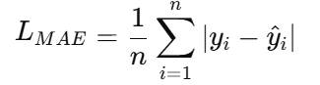
Objective of Training
Any training needs a goal (objective) which can expressed by objective function
Optimizing (minimizing/maximizing) objective function is the target of training
Loss function can serve as an objective function in training
There are many loss functions for different data types and algorithms
Zero-one (Categorical Output)
Predicted Value | Real Value
Underweight | Normal
Normal | Normal
Mean Absolute Error (Scalar Output)

Slide 22
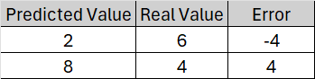
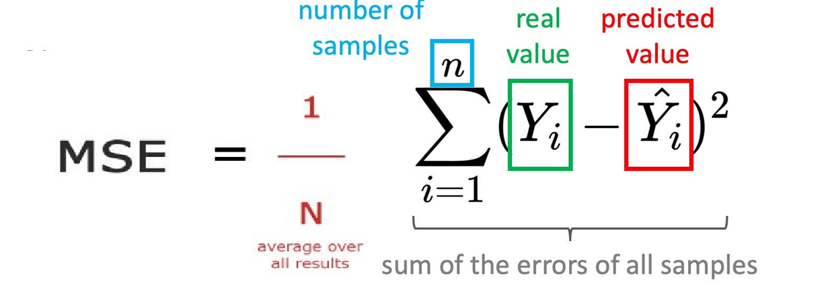
Loss vs Error
Error measures the deviation of an observable value from a prediction
Error = Predicted Value - Real Value
Sum of Errors = (2-6) + (8-4) = 0
Loss is a measure to quantify error in a way that can be used for optimization. Error is not necessarily equal to Loss.
LMSE = Average of Squared Errors = ((2-6)^2 + (8-4) ^2)/2 = (16+16)/2 = 16
(More sensitive to large errors than MAE)
Question: what is the ideal Loss ?

Slide 23
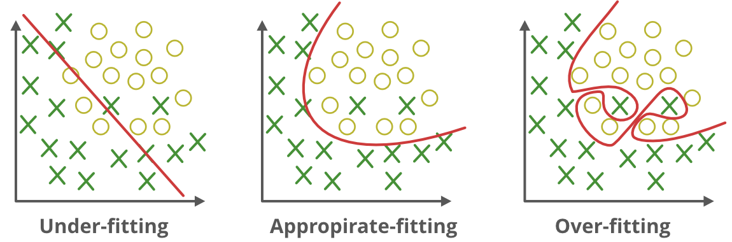
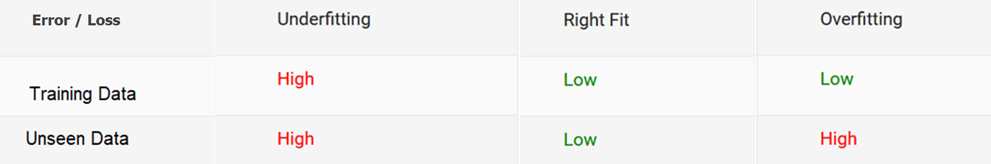
Under-fitting vs Over-fitting
Training
Data
Our goal is not just to create a model that perform well on data used for training the model but also perform well for unseen data

Slide 24
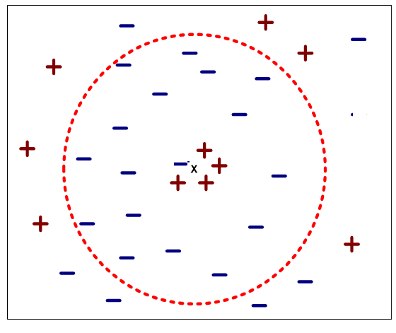
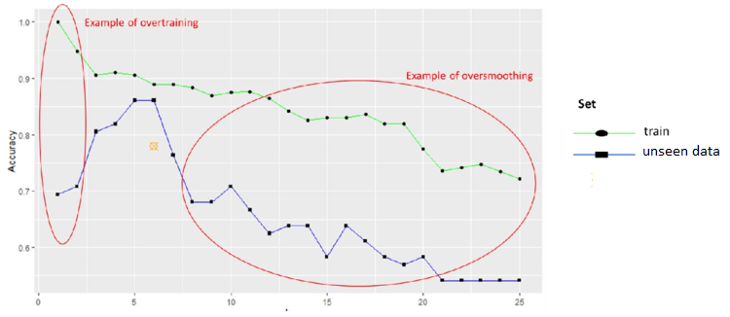
Overfitting and Underfitting - KNN Example
If k is too small, sensitive to noise points in training data (overfitted)
If k is too large, neighborhood may include points from other classes (underfitted)
K (hyper-parameter) needs to be tuned in a way that avoid overfitting and underfitting (right fit)

Slide 25
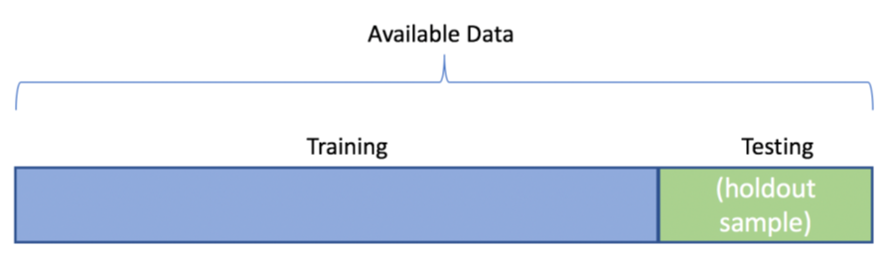
Assessment of Overfitting using Test Data
To minimize the risk of overfitting:
A portion of available data (test set) needs to be set aside to evaluate the model
To check whether the model works well with unseen data (not overfitted), train and test sets should be completely separated.
The test set should not be touched during training
Before training, randomly split the data into training and test sets
The test set must simulate a real-world scenario, therefore, over-sampling , under-sampling, etc. should not be applied to the test data
Problem: Test data can be used for assessment after training. How avoid overfitting during training?

Slide 26
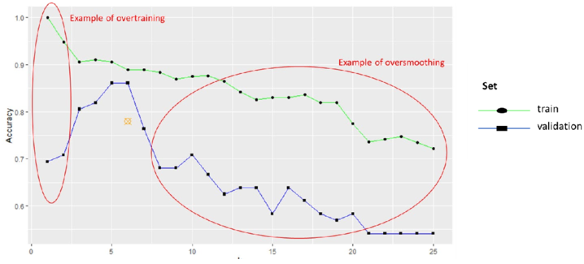
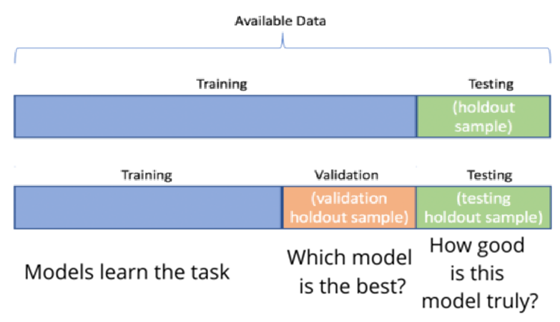
Avoid Overfitting During Training
To avoid overfitting during training we can set a side a part of training data as validation data and test whether the model gets better on unseen data.
Recommended (depends on dataset size):
Train : 65%-85%
Validation : 5%-15%
Test: 10%-30%
Problem: In small datasets, splitting wastes a big potion of data required for training

Slide 27
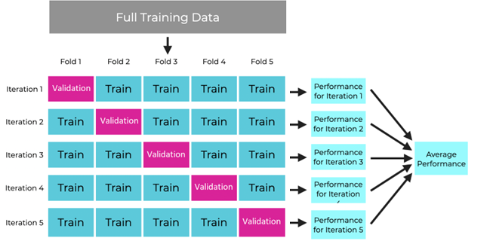
Cross-validation
Split the sample into k equally sized mutually exclusive blocks (folds)
Each block gets to serve as the validation set once, while the remaining blocks serve as the training set (all data is employed for training/validation without wasting)
The performance is evaluated using the average accuracies of K iterations (less bias)
After evaluation of model, all data can be used for training final model
5 folds cross-validation

Slide 28
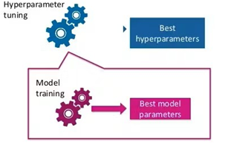
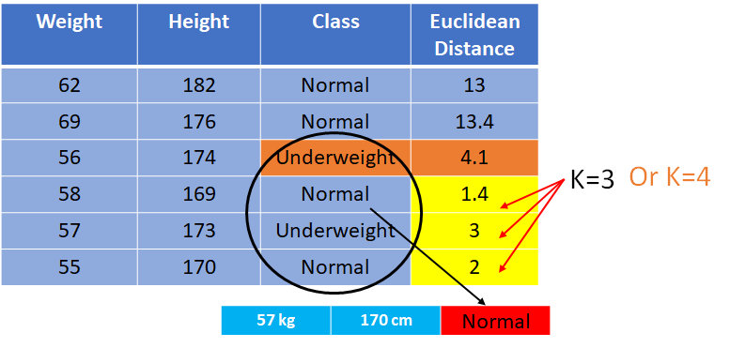
Hyperparameter Tuning using Validation Data
To find the best set of hyperparameters (e.g., K in KNN) using validation data :
List candidate values: List meaningful ranges or values for all hyperparameters
Select candidates: Choose combinations of values using a search strategy ( e.g., grid search: all combinations)
Train using candidates: Train a model for each selected combination of hyperparameters on training set and evaluate on validation set
Select the best set: Select a combination of hyperparameters with the best performance on validation data
Train the final model: Retrain model using the best set of hyperparameters on full training data (including validation data)
Test the model: Test performance of the model on test data

Slide 29
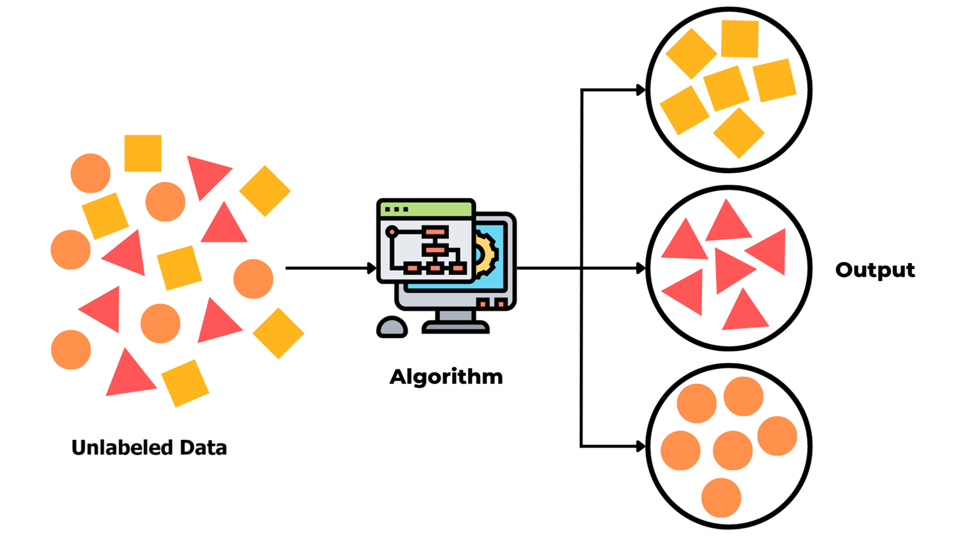
Unsupervised Learning
Task: Investigating patterns / relationships / structures in data
Training data: Just features without labels.
Goals:
Reveal structure of data
Detect similarities
Detect anomalies
Extracting patterns
Summarizing data
Discovering associations

Slide 30
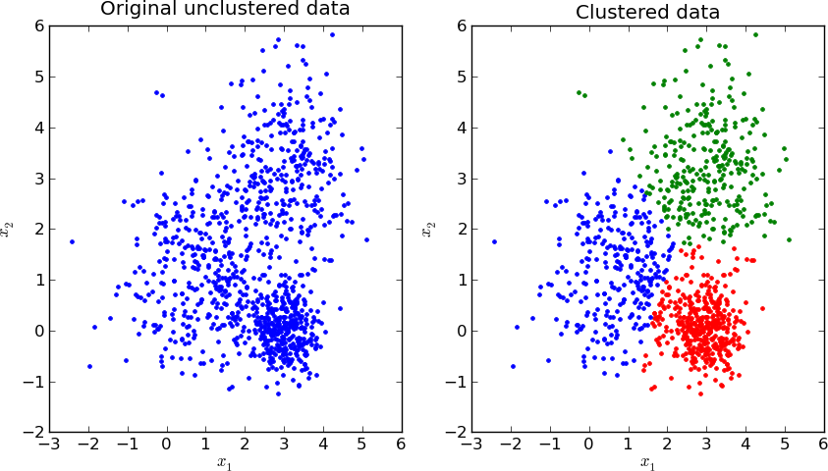
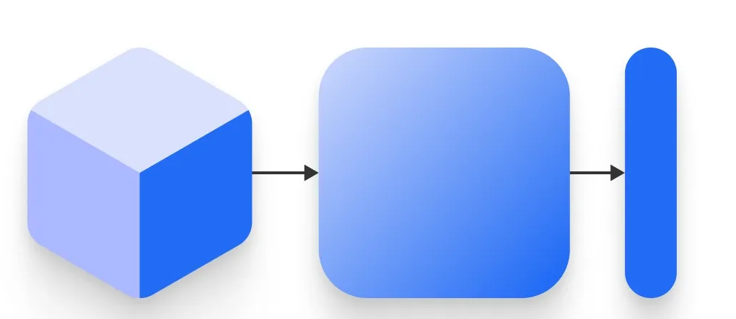
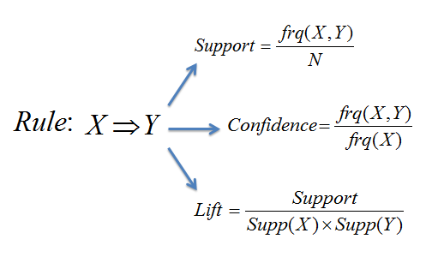
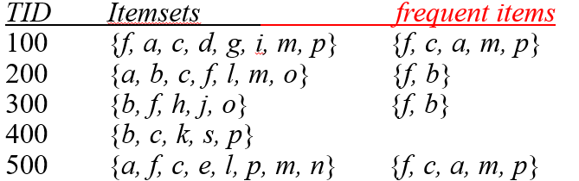
Some Unsupervised Algorithms
Clustering
Learn the grouping structure for a given set of unlabeled inputs
k-Means,
Hierarchical Clustering,
DBSCAN,
..
Feature Reduction
Retain the maximum information using the minimum number of features
PCA,
LDA,
…
Association Rule Mining
A rule-based machine learning method for discovering interesting relations between variables in transactional databases.
Apriori,
FP-growth,
…

Slide 31
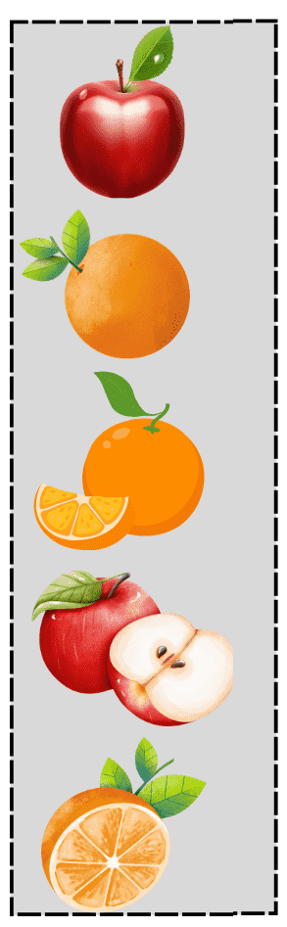

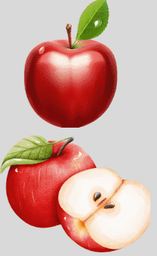
A Typical Unsupervised Learning
Unlabeled Data
“Features”
Clustering
Model
Cluster 2
Cluster 1

Slide 32
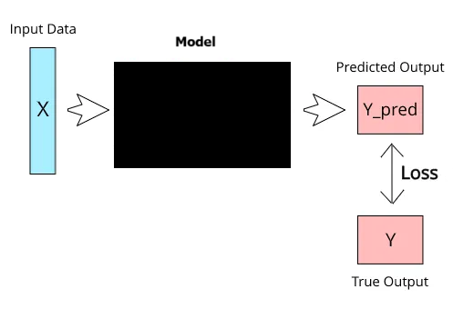
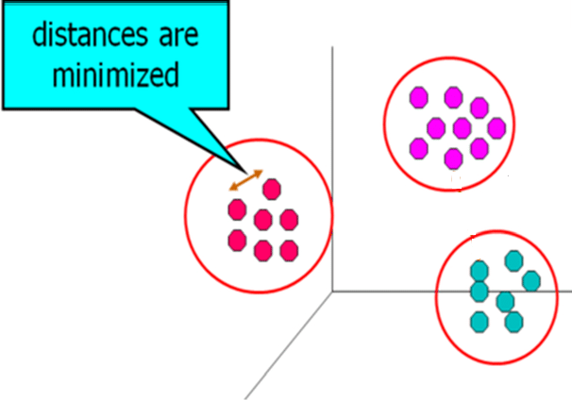
Loss Function in Supervised vs Unsupervised
Training
Supervised learning
A loss function is used to evaluates how well the model predict outputs by comparing predicted labels and real labels
After training and testing the model, we don’t care about the loss function
Unsupervised learning
There are no labels and the loss function evaluates how well the model identifies patterns and relations in data.
Since there is no external label, loss function itself is the goal
The loss function serves as a representation of the data structure the model aims to capture.

Slide 33
Example of Unsupervised Learning- Clustering
Clustering is often an unsupervised learning task as no class values (labels) indicate group of the data instances.
Clustering is a technique for finding similar groups in data, called clusters
Features used to recognize similarity of clusters
Clustering Type

Slide 34
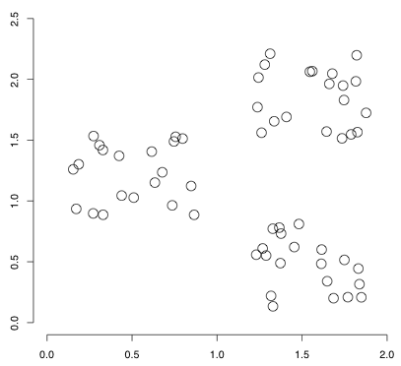
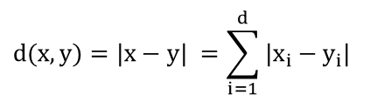
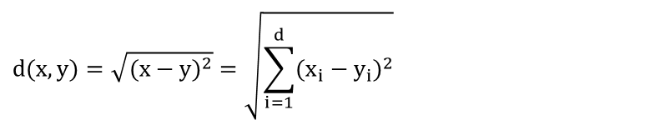
Distance as Loss
Similarity indicates less distance between attributes (features) of two data points
Goal: Least within-cluster distance
Distance measures can be used as the Loss Function in clustering
Euclidean Distance:
Manhattan Distance:
…
$$d(x,y)=\sqrt{(x−y)^{2}}=\sqrt{\sum_{i=1}^{d}{(x_{i}−y_{i})^{2}}}$$
$$d(x,y)=|x−y| =\sum_{i=1}^{d}{|x_{i}−y_{i}|}$$

Slide 35
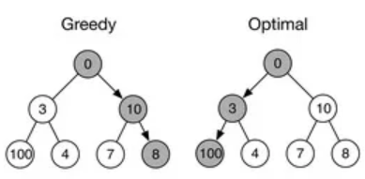
Partitioning Data based on Distance
Problem: Exploring all possible partitions of the data (NP-hard problem) is not feasible for large number of datapoints.
Solution: A greedy algorithm is an iterative problem-solving technique that makes the best local choice at each step to find a solution in a reasonable time
Sometimes, a greedy strategy does not produce a global optimal solution but just can yield locally optimal outcomes.
Example: find the biggest path

Slide 36
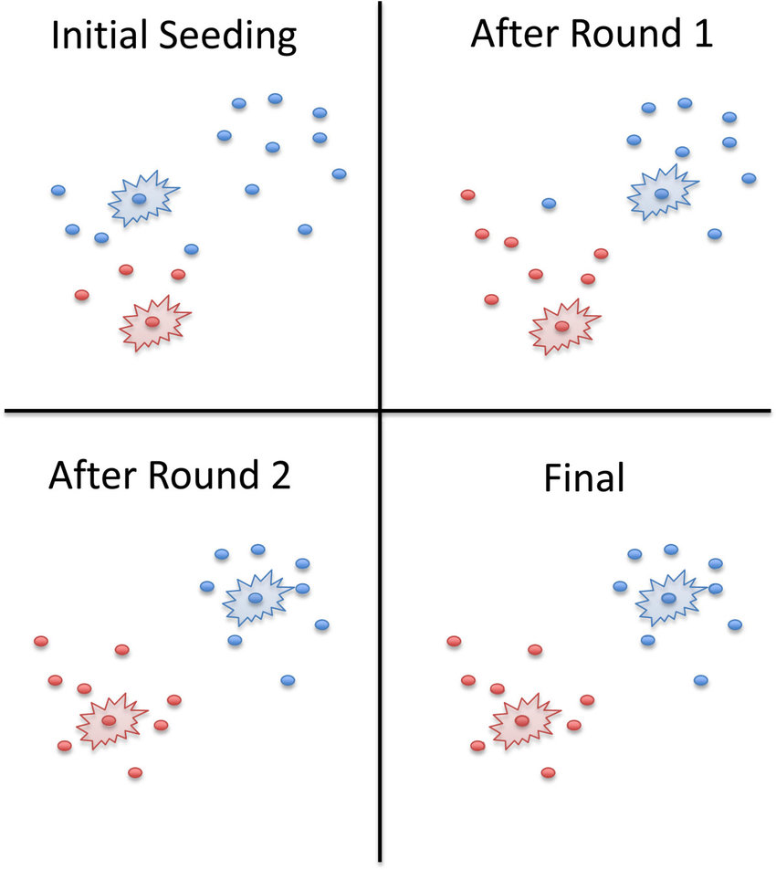
K-Means Clustering Algorithm
A Greedy Idea: In each iteration try to move to the center of clusters using average of features (mean). During multiple iterations, the average moves to the center of a dense region of datapoints
Given k as number of clusters (Hyper-parameter):
Select k random data points as initial centroid (cluster representative)
Repeat:
Assign each data point to the nearest centroid
Recompute centroid of each cluster using mean values of features
Until convergence criteria is met (stability of centroids)

Slide 37
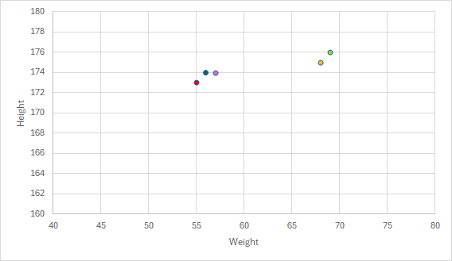
Sample of K-means with two cluster
Features: height(cm) and weight (kg)
No Labels
Weight | Height
68 | 175
69 | 176
57 | 174
55 | 173
56 | 174

Slide 38
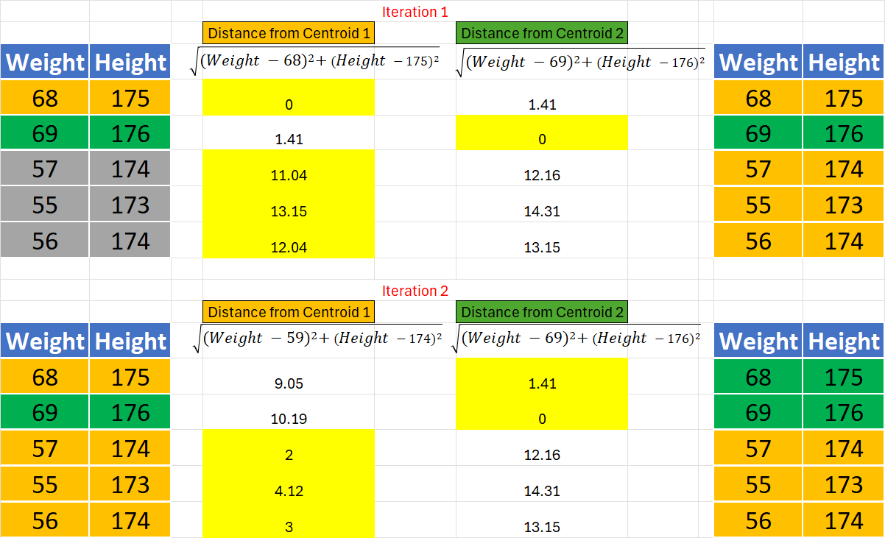
Sample of K-means with two cluster
Choose two random data points as Centroids of Cluster Orange (Cluster 1) and Cluster Green (Cluster 2)
Centroid 1 =
( (68+57+55+56) /4 , (175+174+173+174) /4 ) = (59,174)
Centroid 2 = (69,176)
Repeat Calculation
With Centroids C1, C2
Unless the change in Centroid is less than 1%
Centroid 1 =
((57+55+56) /3 , (174+173+174) /3 ) = (56,173.6)
Centroid 2 =
((68+69) /2 , (175+176) /2 ) = (68.5,175.5)

Slide 39
K-Means Problems - Local Optimal
Greedy Algorithm makes locally optimal choices at each step, Not globally optimum necessarily

Slide 40
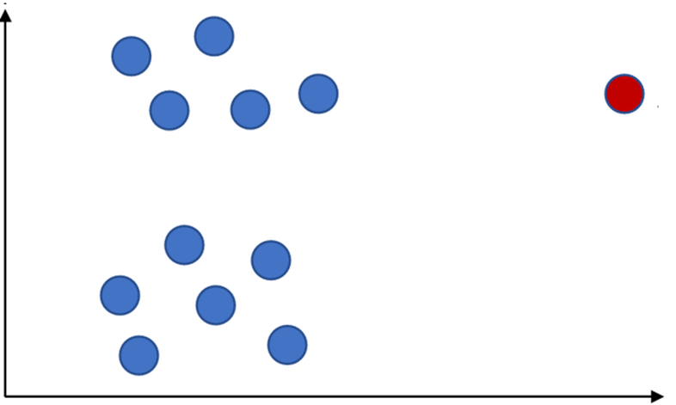
K-Means Problems - Sensitive to Noisy Data
K-means is sensitive to noisy data and outliers
Noisy data can be recognized as a cluster center in K-means
Problem: Many machine learning algorithms are sensitive to noisy data, outliers, missing values, etc.
Solution: Data needs to be pre-processed and cleaned before applying algorithms

Slide 41
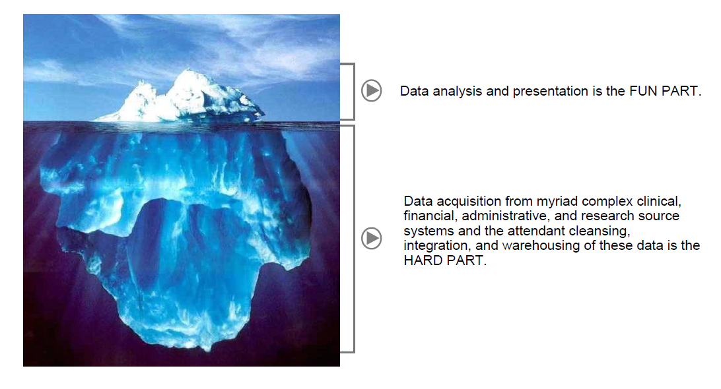
Preparing Data
Oracle
“Cleaning and preparing the proper data for analysis can take up to 80% of a data scientist’s time.”
IBM

Slide 42
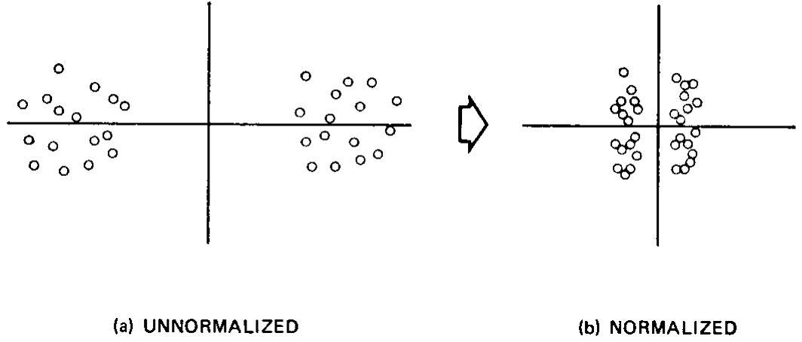
Data Pre-processing for Clustering
Filter out outliers is recommended for many clustering algorithm such as K-means which are prone to outliers
Categorical variables need to be recoded into a series of variables which can then be used in calculation of distance.
Missing Values are required to be imputed before clustering since distance metrics are employed.
Normalizing data is recommended since attributes with larger range of values can bias some distance measures.

Slide 43
Data Preprocessing - Addressing Missing Data
Remove the datapoint: not effective when many datapoints have missing values or dataset is small
Fill in the missing value manually: not feasible when there are many missing values
Fill in it automatically with
a global constant value: e.g., 0, “unknown”, a new class (may create bias)
last reported value in historical data (only works for data with a low dynamicity)
the attribute mean / median / mode (not informative)
the attribute mean for all samples belonging to the same class / group
value of a record with similar other attributes (Hot Deck Imputation)
Imputation using prediction models: predict value of missing data using values of other attributes by a prediction model (e.g., regression)
Multiple Imputations (e.g., MICE)

Slide 44
Multiple Imputation with Chained Equations (MICE)
MICE is a technique used to impute (fill in) multiple variables by modeling each variable with missing values as a function of the other variables in the dataset using a supervised algorithm (e.g., regression).
cran.r-project

Slide 45
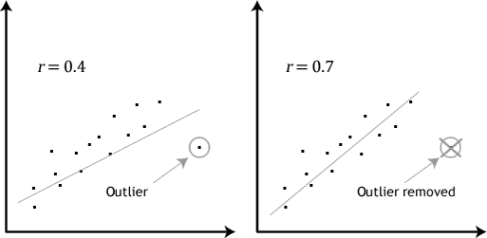
Data Preprocessing - Handling Outliers
Outliers are data points that deviate significantly from the rest of the data
Outliers can influence results of analysis
There are many approaches to detect outliers including IQR, clustering, etc.

Slide 46

Identifying Outliers using Interquartile (IQR)
In interquartile method a set of data is divided into four equal parts (quartiles)
set up a “fence” outside of Q1 and Q3. Any values that fall outside of this fence are considered outliers.
To build this fence take 1.5 times the IQR and then subtract this value from Q1 and add this value to Q3
n= Number of Samples
Q1 = Number at (n+1)/4
Q3 = Number at (n+1)*3/4
In Python : numpy.percentile
neptune

Slide 47

Interquartile - Example
19 Samples
Q1 = Number at (n+1)/4 = (19 + 1) / 4 = 5
Q3 = Number at (n+1)*3/4 = (19 + 1)*3 / 4 = 15
Quiz Scores
14
15
12
13
5
15
11
14
13
13
15
12
12
15
8
13
14
15
15
Automated methods is not necessarily comprehensive (sometimes manual inspection by subject matter experts is needed)
Sort

Slide 48


Addressing Outliers
Outlier as a noise
E.g., age of 200 --> Delete the outlier
Replace the outlier with a value (e.g., median)
etc.
Outlier as a real extreme value (not noise)
E.g., Elon Musk salary --> Deleting valid cases biases your sample
Outlier as output
E.g., detecting fraud --> Outliers are outputs of process

Slide 49

Data Preprocessing - Normalizing Data
Age | Salary
22 | 100,000
24 | 102,000
82 | 101,000
Transform the values of a dataset into a uniform scale (e.g., 0-1)
Some algorithms (e.g., clustering) are sensitive to the scale of the features
min-max normalization: preserve scale but does not handle outliers well. A value between 0 and 1
New value = (Original value - Min) / (Max - Min)
z-score normalization: better handling of outliers but not exact same scale
New value = (Original value - Mean) / Standard deviation
Normalizing can make the outliers less influential.
Normalization can result in a loss of information in some datasets

Slide 50


Data Preprocessing - Categorical Data
In some machine learning models, the inputs should be numeric values:
Ordinal categorical variables: labels that take only a finite number of values with orders (e.g., grades)
Sometimes labels can be replaced with corresponding numerical values in a statistical model
One-Hot encoding usually can be used for converting categories to numerical values
Nominal categorical variables: labels that take only a finite number of values without orders (e.g., colors)
It is wrong to replace labels with different numerical values in a statistical model
One-Hot encoding can be used for converting labels to numerical values

Slide 51

Other Major Tasks in Data Preprocessing
Data cleaning (other steps)
Smooth noisy data, remove duplicates, resolve inconsistencies and discrepancies
Data integration
Data warehousing
Summarizing data
Data reduction
Dimensionality reduction
Numerosity reduction
Data transformation (other steps)
Discretization
Data Balancing

Slide 52

Data Preprocessing - Imbalanced Data
A dataset in which most of examples belong to the same class is not a good training set for learning.
Solutions:
Loss function penalizing wrong classification of the rare class more than the abundant class
Resampling methods to balance data
Right assessment measures present performance of the model on rare classes
Problem:
Training based on maximum accuracy (least error) may ignore rare classes
Imbalanced Balanced

Slide 53

Right Assessment in Imbalanced Data
If there is a dataset with more than 90% percent of one class, a model which classifies all samples into that class will have an excellent accuracy (more than 90%):
In imbalanced data:
Sensitivity and Specificity measures can be useful besides accuracy rate.
Finance: Detecting fraudulent transactions
Healthcare: Diagnosing rare diseases

Slide 54


Model Assessment
Confusion Matrix
e.g., dataset contains 10% positive and 90% negative for a disease :
Using sensitivity measure we can focus on just 10% of positive cases

Slide 55


Model Assessment – Other Measures
Precision measures the accuracy of the positive predictions
The F1 score combines precision and recall (sensitivity) into a single metric (using harmonic mean) useful for evaluating model on imbalanced data
The F1 score ranges from 0 to 1, where 1 represents perfect precision and recall, and 0 represents poor performance

Slide 56



Model Assessment – Example
White-box ML models were applied to the Urgent Care Assessment Dataset to evaluate their effectiveness in predicting sepsis based on symptom severity scores.
TP = 14, FP = 7, TN = 7, FN = 0
$$\text{Accuracy}=\frac{TP+TN}{TP+TN+FP+FN}=\frac{14+7}{14+7+7+0}=0.75$$
$$\text{Sensitivity}\text{(}\text{Recall}\text{)}=\frac{TP}{TP+FN}=\frac{14}{14+0}=1.0$$
$\text{Specificity}=\frac{TN}{TN+FP}=\frac{7}{7+7}=0.5$
$$\text{Precision}=\frac{TP}{TP+FP}=\frac{14}{14+7}=0.667$$
$$F1=2×\frac{\text{Precision}×\text{Recall}}{\text{Precision}+\text{Recall}}=2×\frac{0.667×1.0}{0.667+1.0}=0.8$$

Slide 57

Supervised vs Unsupervised
Advantages of Supervised Learning:
Easier to evaluate (compare predictions to labels)
Higher accuracy if enough labeled data is available
Problems:
Few labeled data are available compared to unlabeled data
The labeling process is costly, slow, and requires domain expertise
Supervised learning is prone to overfitting when labeled data is small
The dataset may have imbalanced labels

Slide 58

Semi Supervised Learning (SSL)
Between supervised and unsupervised learning.
Limited labeled data and a large amount of unlabeled data
Example 1:
Cluster all data (labeled + unlabeled)
Use the labeled data in each cluster as the label of all members
Example 2:
Train a classification model using labeled data
Use the trained model the predict class of unlabeled data (pseudo-labels)
Train a model using both originally labeled and predicted labels
medium.com

Slide 59

Expanding Training Data
Limited labeled data
Expand labeled data artificially
Example 1:
Apply transformations to labeled data without changing its semantic meaning to create more labeled data (Data Augmentation)
E.g., using rotating, scaling ,flipping, etc. on a few labeled picture to create more picture for training a neural network
Example 2:
Generate entirely new data artificially using models or rules (Synthetic Data)
E.g., using teacher models in distillation to generate training data for student model

Slide 60




Hybrid Approaches
No labeled data
Learning structure of data using unsupervised models
Use the charachteristics of data structure for labeling the data
Use labled data for supervised learning
Unlabeled data
Clustering
Normal
Using labeled data in other ML models
Underweight

Slide 61

Self-Supervised
No labeled data
Define an artificial training task (pretext task) in a way that:
Automated generation of labels from the data itself is possible
Model can learn useful patterns during training
Example 1:
Predict color of picture (pretext task): Convert a color picture to grayscale then train a model to predict missing colors (uses the initial colors as labels)
Example 2 (This approach is used for pre-training LLMs):
Predict missing word (pretext task) : Remove a word from a text then train the model to predict the missing word (uses the removed word as label)

Slide 62

Reinforcement Learning
Learning optimal behaviors in an environment
In reinforcement learning, there is no answer/ label
Goal: obtain maximum rewards (and less penalties)

Slide 63

Reinforcement Learning – Toy Example
marutitech

Slide 64


Reward Model as Objective Function
A reward model defines the objective function for the training.
Reward tells the agent what is considered good or bad action by assigning numerical values to the outcomes of its actions.
The agent is trained to do the best action (a) for each state (s) which is called policy (π)
The goal is to develop a policy which maximizes the expected cumulative reward, which comes from the reward model:

Slide 65

Types of Analytics
What should be done?
What is likely to happen?
Descriptive
Reinforcement Learning, Decision Support Systems, …
Why did it happen?
Regression, Classification
What happened?
Correlations, Association Rule Mining, …
Gartner
Visualizations, Reports, …
Hindsight
Insight
Foresight

Slide 66


Descriptive Analytics - Data Exploration
Providing insights through reports and visualizations.
First steps in analytics, to summarize and clean the raw data.
Histogram shows distribution and structure of the data
Scatter plot showing noises and outliers

Slide 67


Descriptive Analytics – Understanding Data
Focuses on describing data to understand what has happened in the past.
Time-series data
Scatter plots showing the correlations between two features (from –1 to 1)
Line chart showing the trends

Slide 68



White-box vs. Black-box ML
White-box (Glass-box):
Interpretable results for developing data-driven theories
Transparency makes more reliable results than opaque models
Black-box:
Higher predictive accuracy
More complex tasks

Slide 69




White-box Model- Example
https://www.sciencedirect.com/science/article/pii/S0167587724001478

Slide 70


Black-box Model - Example
LLMs are powerful black-box models
LLMs show significant advantages over most human doctors in medical diagnosis
The main disadvantage of LLMs is their inability to be explained.
https://doi.org/10.1371/journal.pdig.0000341

Slide 71

Prescriptive Analytics – Explainability Problem
Some application needs more interpretability
More impactful decisions, needs more explainability
Explainable AI tries to address this issue
1
Impact
0
0
Explainability
1

Slide 72

Explainable AI
Model-agnostic approaches :
Feature Attribution: Highlight which parts of the input most influenced the model’s output (e.g., SHAP)
Surrogate Models: Train a simple, interpretable model (white-box) to approximate a complex one (e.g., LIME )
…
Model-specific approaches:
Transformers : Representation of the attention weights learned in an attention mechanism (e.g., using Attention Heatmaps)
…
https://arxiv.org/pdf/1906.05714

Slide 73
Assignment 1
The target dataset contains information of heart conditions and “HeartDisease” column (label) that indicates whether the patient has a heart disease(1) or not (0)
Develop a code using a common programing language (Python, R, Java, C#, C++, etc.) to:
-Split data into training (72%), validation (8%) and test (20%)
-Train three models of KNN-3, KNN-9 and KNN-21 using training data to predict label (last column) based on the other columns (features)
-Calculate the accuracy of three models on the validation data
-Select the best K among these three models
-Train a model using the best K on both training and validation data
Calculate the accuracy of the model on test data
Train a k-means model with two clusters on all feature data
Visualize the two clusters using MaxHR and Age
Submit the code and the results in Canvas as follows:
File name of Code : HW1_Code.[file type] (e.g., HW1_Code.py )
File name of Result : HW1_Result.docx
Age | RestingBP | Cholesterol | MaxHR | HeartDisease
40 | 140 | 289 | 172 | 0
49 | 160 | 180 | 156 | 1
37 | 130 | 283 | 98 | 0
48 | 138 | 214 | 108 | 1
54 | 150 | 195 | 122 | 0
39 | 120 | 339 | 170 | 0
45 | 130 | 237 | 170 | 0
54 | 110 | 208 | 142 | 0
37 | 140 | 207 | 130 | 1
48 | 120 | 284 | 120 | 0

